Slide 1
Welcome to Advisory
November 14, 2019
Survey Time (please get a Chromebook before we begin)

Slide 2
Learning Target
Today we will take a survey to gauge your opinions on a variety of school-related topics. School administrators make decisions for our school based on this survey.

Slide 3
EOS Survey
Use this link to complete the survey on your Chromebook or using a smartphone:

Slide 4
Guide to Taking Online Student Surveys
Notes:
SEL - Social Emotional Surveys

Slide 5
Step 1:
Go to the following website (type it exactly as it appears) or use the link the class website.
Smithcsrobot.weebly.com/advisory-group.html
https://eos.co1.qualtrics.com/jfe/form/SV_e3TEBet5Cev1KwR

Slide 6
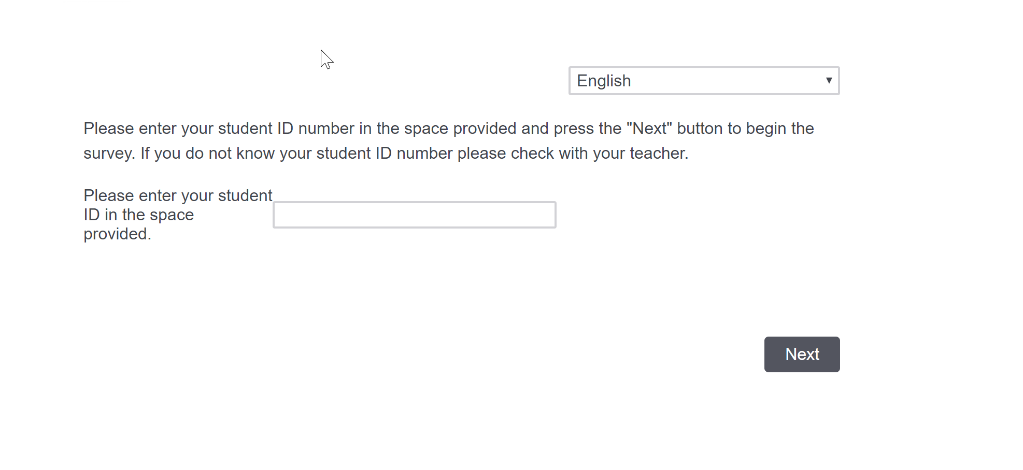
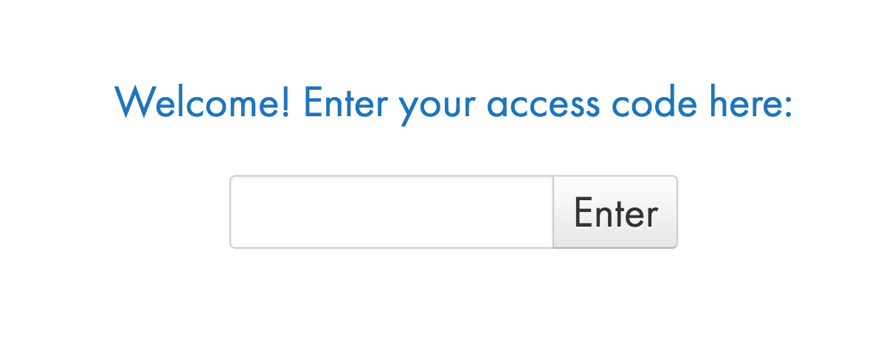
Step 2:

Slide 7
Step 3:
Choose an answer for each question. The answers you provide to this section of the survey are completely confidential - no one will be able to connect your answers back to you.

Slide 8
When you are done, update your calendar for the 2nd six-weeks from your teacher.
Also, your class may be spending some time looking at the career spotlight if you did not get to it Nov. 7.

Slide 9
Thinking about becoming a Banker/ Financier?
Here’s what to expect...

Slide 10
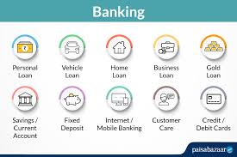
What does it take?
Are you…
Interested in Accounting, handling money, or analyzing investments?
Good at problem solving and paying attention to detail?
Good with money/ money management and people?

Slide 11
How much money will I make?
According to Zip Recruiter:
Bank Teller: $20-35K/year
Branch Manager or Financial Advisor: $50-100K/year
In General, 30 year career. Seasonal or steady. 20% of Financial Advisors are self-employed (BLS).

Slide 12
Education and Training
According to the U.S. Bureau of Labor Statistics (BLS), except for customer service positions, most careers in banking or finance require a post-secondary degree.
Associate’s Degree (ASD, AA, ABA)
Business Admin, Accounting
Bachelor’s Degree (B.S. or B.A.)
Business Admin, Accounting, Finance, Marketing, Economics
Master’s Degree (M.A. or M.S. or MBA); Philosophy Doctoral Degree (PhD)
Business Admin, Accounting, Finance, Marketing, Economics
Professional certifications
Insurance (CPCU, AIC, AIS, API), CFA, CPA

Slide 13
Exit Slip: What do you think?
Is a career in banking or finance right for you?
Benefits? Drawbacks?

Slide 14
Thanks for your feedback!
It’s always a great day to be a Titan!

